Slide 1


You may hear your child talking about “Good to be Green.”
Reminders:
am Nursery
8.30 - 11.30
pm Nursery
12.15-3.15
30 hours
8.30-3.15
30 hours lunch
11.30-12.15
Please name ALL clothing.
Please ensure that your child has their own bag containing spare clothes etc.
We always need junk boxes so please feel free to bring them into Nursery.
This is a Behaviour Management Scheme which encourages positive behaviour in and around our school. Yellow and red cards may be given for negative behaviour and green and silver “privilege cards” are awarded for positive behaviour.
New Delaval Primary School
Spring 2
Nursery
2025-26
School contact number 01670 353255

Slide 2
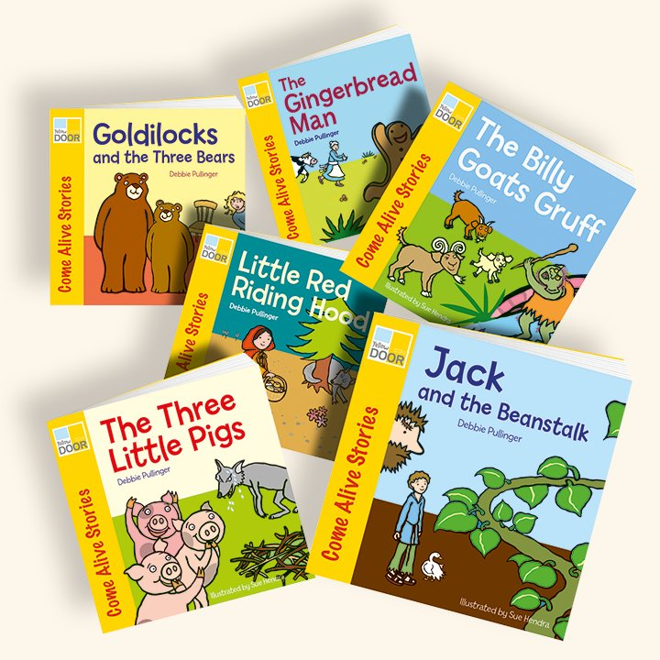
Overall Topic:
Traditional tales
Traditional tales
Read a variety of stories to your child.
Make puppets of different characters to retell the stories.
Make a fairytale castle.
Encourage your child to become independent when putting own their own coat and zipping it up.
Spring Term 2
Dear Parent/ Carer,
Our literacy focus is...
Traditional tales
During this term we will be finding out about families and different cultures. This booklet has some ideas you could do at home to support your child with their learning and development.

