Slide 1
You may hear your child talking about “Good to be Green.”
Reminders:
Please arrive at school for 12.30 pm and collect at 3.15/3.30.
Please name ALL clothing.
Please ensure that your child has their own bag containing spare clothes etc.
Would always need junk boxes so please feel free to bring them into pre-school.
This is a Behaviour Management Scheme which encourages positive behaviour in and around our school. Yellow and red cards may be given for negative behaviour and green and silver “privilege cards” are awarded for positive behaviour.
New Delaval Primary School
Summer 2
Preschool
2022
School contact number 01670 353255

Slide 2
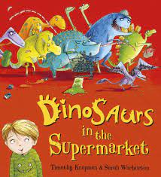
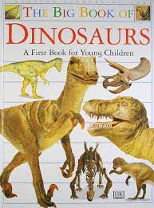
Dinosaurs in the Supermarket
Overall Topic:
Dinosaurs
Different types of food
Literacy Focus:
Dinosaurs in the Supermarket
Read the story with your child.
Talk about dinosaurs and what they look like, what do they eat and try and remember some Dinosaur names.
Draw a your favorite Dinosaur.
Summer Term
Dear Parent/ Carer,
Our literacy focus is Dinosaurs in the Supermarket
During this term we will be finding out all about Dinosaurs and different types of food. This booklet has some ideas you could do at home to support your child with their learning and development.

