Slide 1
You may hear your child talking about “Good to be Green.”
Reminders:
Times of the day
pm session 12.30-3.15 /3.30
Please arrive on time and collect promptly.
Please name ALL clothing.
Please provide spare clothing for your child
Our Learning bags we be sent home weekly. There are lots of exciting activities that you can enjoy with your child at home.
This is a Behaviour Management Scheme which encourages positive behaviour in and around our school. Yellow and red cards may be given for negative behaviour and green and silver “privilege cards” are awarded for positive behaviour.
New Delaval Primary School
Spring 2
Preschool
2023-2024
School contact number 01670 353255

Slide 2
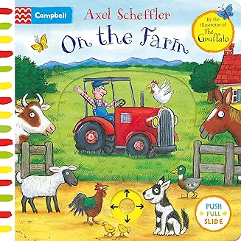
Spring 2 Term
Literacy Focus:
In the Jungle
The Tiger Who Came to Tea.
On the farm.
Ten Cheepy Chirpy Chicks
Try to find time to read a story to your child each day.
Encourage your child to become independent when putting own their own coat.
Sing counting songs and Nursery rhymes.
Use sticks and mud to encourage your child to draw lines and circles.
Take your child on a walk to your local park.
Dear Parent/ Carer,
This half term our topics are going to be:
Jungle animals, The tiger who came to tea, On the farm and Easter celebration
This month we celebrating
World Book day, Mothers Day, Easter and Red Nose Day. Look out for letters with further information.

